Slide 1
Solution Analysis and Recommendations
Tools:
Alternatives, Impact Matrix and Scenarios
Case:
Westjet Pearson Decision

Slide 2
Standard Strategic Analysis Framework
Vision, Goals,
and Strategy
Strategic
Issue/Vision
Implementation
Situation
Recommendations
External
Analysis
Solution
Analysis
Internal
Analysis
Performance
Analysis

Slide 3
Solution Analysis Using Performance Metrics
Solution Analysis is a method for overcoming identified gaps. It involves six steps:
Run gap analyses.
Generate broad set of alternatives that would be possible and select 2-3 specific alternatives to examine.
Assess the goals and vision of the organization and the specific, operational criteria for meeting it.
Generate an impact matrix to assess alternatives. Choose one.
Evaluate different scenarios of chosen alternative.
Finalize your recommendations.
Solution Analysis
1) Gaps
2) Alternatives
3) Goals & Criteria
4) Impact Matrix
5) Scenarios
6) Final Recommendation

Slide 4
1. Gap Analysis
To link current performance and solution analysis, all in light of the current strategic initiative, analysts often do “gap analysis”.
E.g., the initiative or objective:
NIKE to keep growing at a certain % ROIC (Capital)/year
Virgin to find new business challenges.
The gap assesses where the organization is currently now and likely to be in the near future as opposed to where it wants to be.
Comparing:
Historical
future data (quantitative or qualitative)…

Slide 5
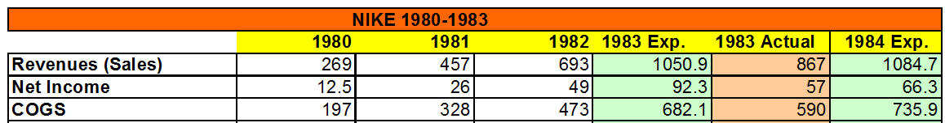
NIKE : Gap Analysis of Plateau Issue 1983-84
COGS – Cost of Goods Sold

Slide 6
One View of WestJet Gaps
(Route length (miles))
@ Courtesy of Ioana Popescu

Slide 7

2. Develop and Choose Alternative’s
An alternative is a bundle of related solutions.
Several are possible in most cases, often mixing external, internal and performance features. These are listed on the next slide…
In a NIKE example for 1983, two good, but different, bundles (alternative solutions) would be considered:
Better HR and internal rationalization of NIKE
New marketing and expansion of NIKE

Slide 8
NIKE 1983 Possible Alternatives to the Plateau Issue
Options Based on External Analysis
Go into hotter lines of sports (those with more growth)
Expand into Europe
Rationalize current product lines
Opportunity of embracing new celebrities
Options Based on Internal Analysis
Improve Internal Communication & Decentralize Decision Making
Improve Efficiency, especially in Inventory Control (maybe an ERP system)?
Modernize Human Resources

Slide 9
WestJet Alternative solutions?
Go to Pearson
Hub-and-spoke model at Pearson airport
Point to Point model
Abandon Hamilton
Stay in Hamilton
Use a JetBlue business model at Pearson airport
Use a WestJet business model at Pearson airport
 |  | Pearson |  | Hamilton
 |  | Yes | No | Yes | No
Business Model | WJ Model |  |  | x
 | JB Model | x
System | Point-to-Point |  |  | x
 | Hub–and – Spoke | x

Slide 10

3. Assess Goal’s and Criteria
NIKE adopted goals
Be a leader in high end sports.
Make money for shareholders
Treat employees well
“Do Good”
NIKE actual goals?
Make money for Phil Knight?
Grow the company?
Make the brand big?
Compete
CSR / HR last…?
The goal or objective of the organization need to be determined.
These might be stated or unstated; and sometimes the unstated is the real goal.

Slide 11
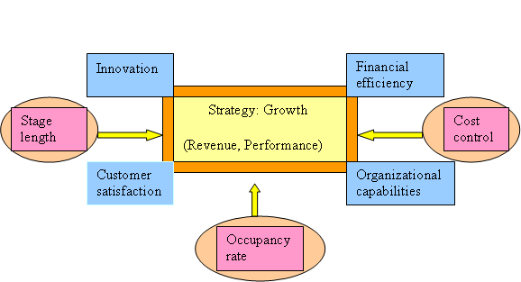
Westjet’s Business Model
Southwest Model
JetBlue Model

Slide 12
Possible Criteria from the Model

Slide 13
4. Generate An Impact (Solution) Matrix
The Impact Matrix is used to compare alternatives or options.
The Impact Matrix should contain quantitative (empirical) and qualitative (information) decision criteria..
 | Option 1 | Option 2 | Option 3 | Other
Criterion 1
Criterion 2
Criterion 3
Criterion 4
Choice

Slide 14
NIKE Example
Alternative 1. Better HR and internal rationalization of NIKE
Alternative 2. New marketing and expansion of NIKE
Circa 1983-85.

Slide 15
Possible Westjet Impact Matrix
Note: Try to quantify as many of these factors as possible.

Slide 16
5. Choose and Refine One Alternative solution via Scenario Analysis
One alternative should be chosen using the type of strategic ratification procedure your organization likes
Voting
consensus-building
clear rational dominance of one alternative over another, etc.
Alternative solutions should be examined in more depth through:
scenario analysis
Positive
Neutral
negative
sub-recommendations developed
Sometimes scenario analysis makes it clear that the alternative needs substantial modification, but must be dropped in favor of an earlier one.

Slide 17
Nike Solution
In the NIKE example, the final solution chosen was the:
HR improvement and internal rationalization of the supply chain and communication functions
Also to move into basketball heavily with the signing of Michael Jordan.
The scenario analysis may have looked like those below. If Michael Jordan hadn’t come through and the pursuit of this market looked like NIKE was just dumping its internal changes, it might have blown up in Knight’s face…

Slide 18
One Westjet Scenario Analysis
C= Op. Margin
O= Occupancy
S=distance

Slide 19
6. Finalize Your Recommendations
NIKE Example: Given the possible downside, the recommendations that might have discussed was:
how long to commit to basketball?
how to make this move look like a natural next step?
The really interesting thing is that Phil Knight actually took a leave for a one year and put an HR-internal operational specialist from the board in charge as acting CEO… some say that way Knight would not have to be the “fall guy” if things hadn’t worked out!

Slide 20
What are your Westjet Recommendations?

Slide 21
Possible Final Recommendation for Westjet
My recommendation for Westjet is to keep its most important Hamilton operations and expand to Pearson now, taking advantage of its core internal strengths and external opportunities. This overall strategy will give Westjet a competitive edge, adding value to their service for all shareholders, in a hard to imitate way because this mixes resources management with their core capabilities and culture. The implementation of this strategy is based on the actual tactics in both airports, adjusted for an expansion in Pearson as the main goal while protecting the actual market share in Hamilton. In the change and implementation process the organizational culture and glue have to be nurtured and protected.
Strategy Seminar Participant

Slide 22
Timeline of Actual Outcomes in Pearson Decision

